Slide 1
Reakce rafinérsko-petrochemického komplexu na budoucí výzvy v rámci Green Deal
datum:
25/11/2021
jméno:
Jiří Hájek, ředitel a předseda představenstva, ORLEN UniCRE

Slide 2
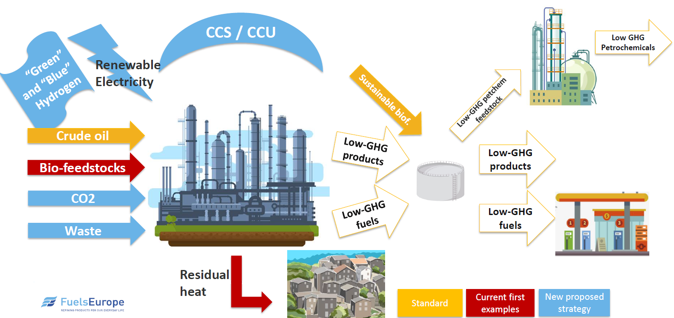
Fuels production vision 2050

Slide 3
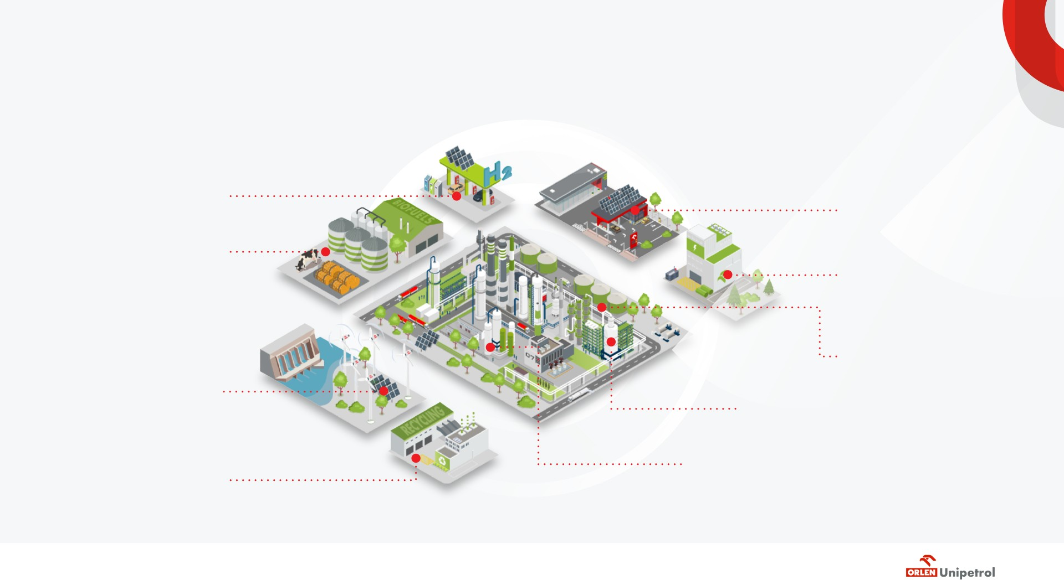
Utilization of new attractive opportunities
Hydrogen
E-mobility
Advanced biofuels (biogenic and municipal waste)
Green NH₃ as energy caries
Steam-gas energy block
Renewable sources of energy
Bio-petrochemicals and recycled polymers
Waste plastic recycling
Bio-products from existing refinery asset

Slide 4
Biofuels production
Ambition:
RED II (III) compliance;
Reduction of carbon footprint related to automotive, marine and aviation fuels utilization;
Focus:
Forest and agriculture residuum, municipal waste;
Key challenges:
Waste biogenic feedstock provision → effective collection, storage, analysis, pretreatment;
Technology maturity → TRL level, feedstock flexibility, feed quality sensitivity, yield of desired products, energy and hydrogen consumption, undesired product/waste utilization;
Co-processing vs stand alone installation;
Blending potential with existing fuels → RON, CI, stability, oxygen content;

Slide 5
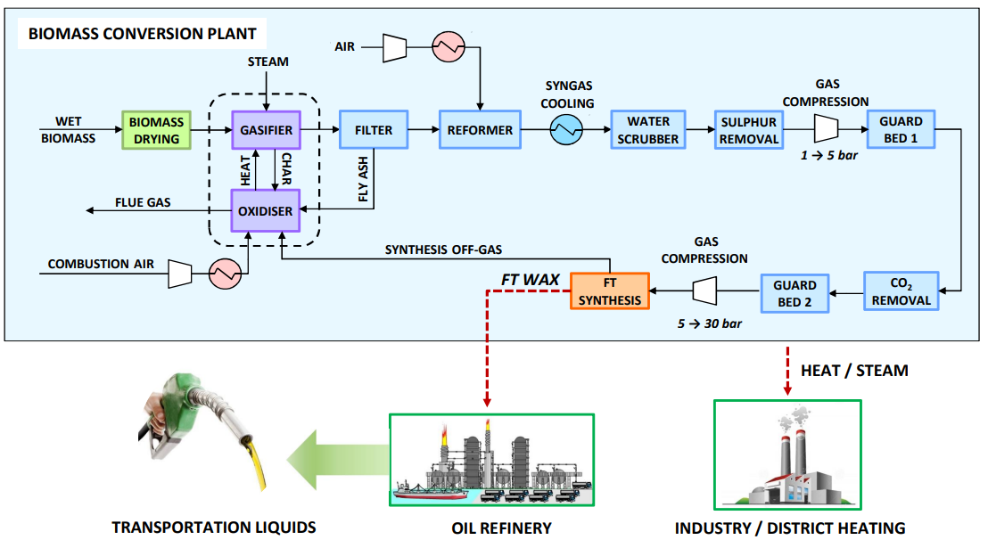
COMSYN process concept
Main Targets :
Concept: decentralized primary conversion of biomass in 30 – 150 MW units.
Target: reduction of biofuel production cost up to 35% compared to alternative routes → production cost for diesel lower than 0.80 €/l.
GHG savings: 80 %
Overall efficiency to FT biocrude + heat: 80%

Slide 6
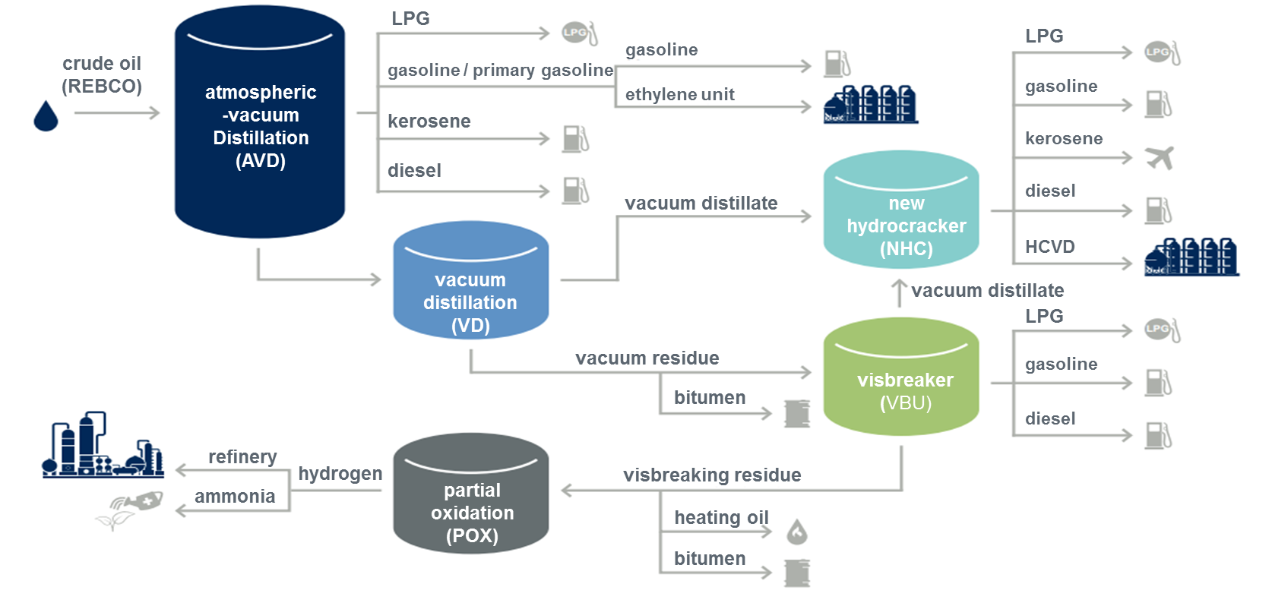
Simulation processing in existing refinery
80% reduction in the GHG emissions was reached for studied case
Obtained Production cost for biofuel is 1.10 EUR/l
FT WAX >10 wt.%
Green NH₃ as energy caries
The Break-even price of FT Biofuels after refining upgrade is at 1.7 EUR/kg
BENEFIT
No benefit
CURRENTLY
84 wt. % of FT Oil+Wax is converted to motor fuels.
14 wt. % of FT Oil+Wax is converted to Steam cracker feedstock.
2.6 wt. % of FT Oil+Wax converted to fuel gas
Notes:
The real break-even price of FT Biofuels produced from FT Wax+Oil has to include the effects associated with the fact that 14 % of feed is lost in Steam cracker feed pool and 2,6 % feed is lost in Refinery Fuel Gas.
Due to the current plastics EU policy and customers requirements (Unipetrol´s customer survey), side products used for basic-plastics Production (polyethylene, polypropylene) and fuel gas have to be priced with a significantly lower value (as a fossil equivalent) than purchase cost of FT WAX+Oil.

Slide 7
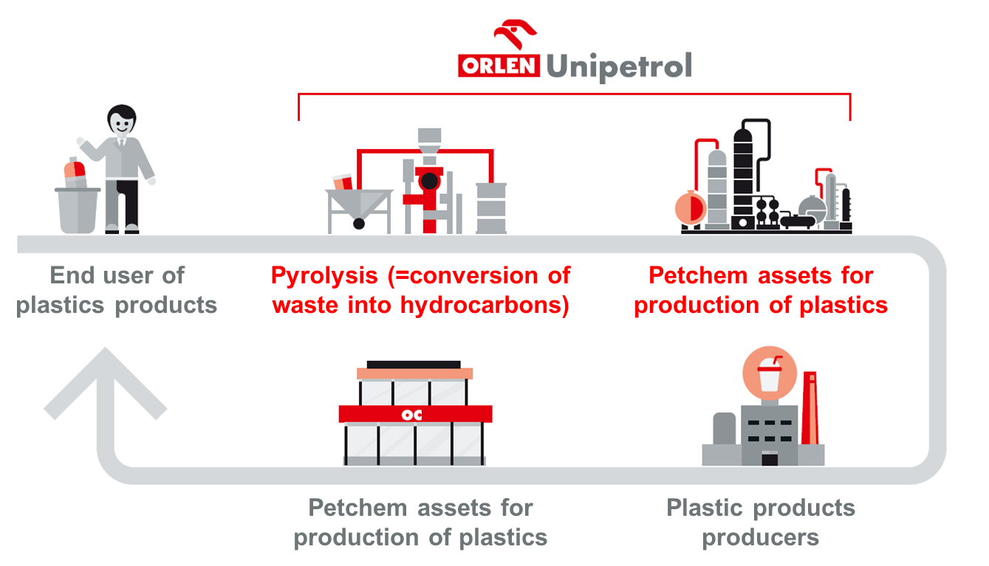
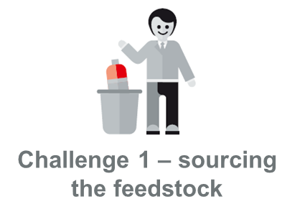
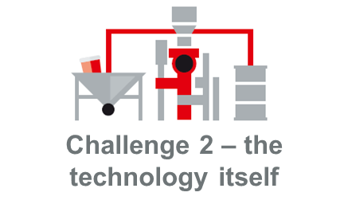
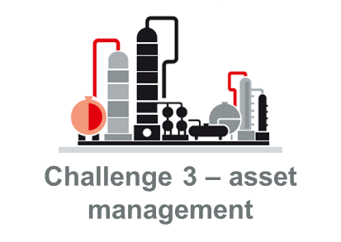
Chemical recycling of waste plastics & EoL tires
Project description:
To develop/implement concept of chemical recycling via pyrolysis scalable to production capacities of from 90 ktpa (2030) to 180 ktpa (2040) of pyrolysis oil.
Focus on key challenges:
Establish strategic partnerships with waste management sector → Challenge 1 – sourcing the feedstock.
Remove „high“ risk contaminants (fluorine, chlorine, bromine, metals) → Challenge 2 – technology itself:
Option 1 – „smart pyrolysis“ – in-house or external technology.
Option 2 – „on-line“ dehalogenation.
Option 3 – „off-line“ dehalogenation.
How to plan utilisation of current/new assets to achieve the most cost-effective solution for chemical recycling with short time-to-market → Challenge 3 –asset management with chemical recycling.
Key enablers? Solving following challenges:
Opportunities:
To introduce sustainable feedstock into production of petrochemicals (company level).
Recognize responsibility and offer solution for sustainable plastics (company + global level).
Reduce GHG emissions from waste plastic incineration (global level).
Current status:
Challenge 1 – dialogue with waste management sector – ongoing.
Challenge 2 (refer to roadmap in appendix section) – all options under development (lab-scale PoC), joint activity with ORLEN CG (Case Razem/Spolu).
Challenge 3 – bussines cases in preparation, first PIMS calculations carried out, characterisation methods developed.

Slide 8
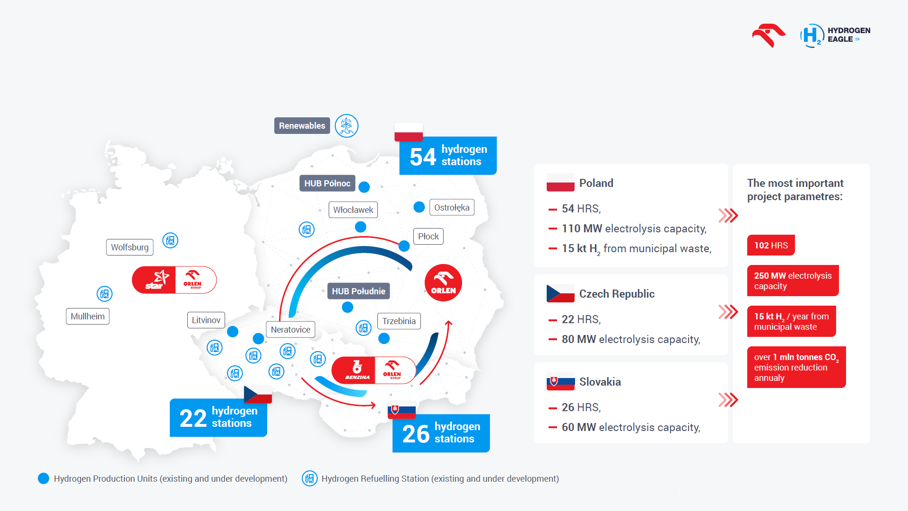
Hydrogen Eagle – green hydrogen for CEE

Slide 9
LCA of ICE / BV / FCV
Production, distribution and energy consumption
g CO₂ / km
Vehicle production and post-treatment
g CO₂ / km
Total life cycle emission
g CO₂ / km
140-210
mainly production and combustion of fossil fuels
40-60
relatively lowest
180-270
lowering (mainly advanced)
ICE
10-100*
as per energy source, higher efficiency then FCV
~ 150
battery production and limited recycling potential
160-250
future reduction via new ECO friendly batteries with higher recycling potential
BV
20-120
as per the source of energy and hydrogen production technology
~ 110
battery Production and carbon fibers in high pressure vessels
130-230
dynamic development, future emission reduction
FCV
* Emission during life cycle relay on energy source where coal represents the highest and RES the lowest.
Source: Deloitte, Ballard – Fueling the future of mobility, 2020

Slide 10
PRODUCER
CUSTOMER

Slide 11
Thank You for Your attention

