Slide 1

Mondi Štětí Introduction

Slide 2


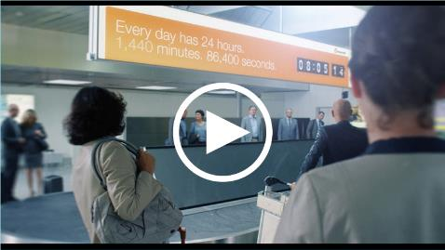
IN TOUCH EVERY DAY
Our products touch the lives of
millions, every day.

Slide 3
Mondi Group
We are an international packaging and paper Group, employing around 25,000 people across more than 30 countries.
Our key operations are located in central Europe, Russia, North America and South Africa.
*
Packaging Paper
Fibre Packaging
Consumer Packaging
Uncoated Fine Paper
Containerboard
Corrugated Packaging
Consumer Goods Packaging
Sack Kraft Paper
Industrial Bags
Personal Care Components
Speciality Kraft Paper
Extrusion Coatings
Release Liner
Technical Films

Slide 4



















Integrated value chain
Paper for recycling
Corrugated
packaging
Paper mill
Recycled and virgin containerboard
Box plant
Forest
Pulp mill
Pulp
Office and professional
printing paper
Forest
Pulp mill
Pulp
Paper mill
Uncoated fine paper
Finishing
Industrial bags
Pulp
Extrusion coatings
Pulp mill
Paper mill
Sack kraft paper and
speciality kraft paper
Converting plant
Advanced materials: release liner
Advanced materials: films and hygiene components
Advanced materials: release liner
Film extrusion plant
Films
Converting plant
Consumer goods
packaging

Slide 5
Kraft pulp chemicals cycle

Slide 6
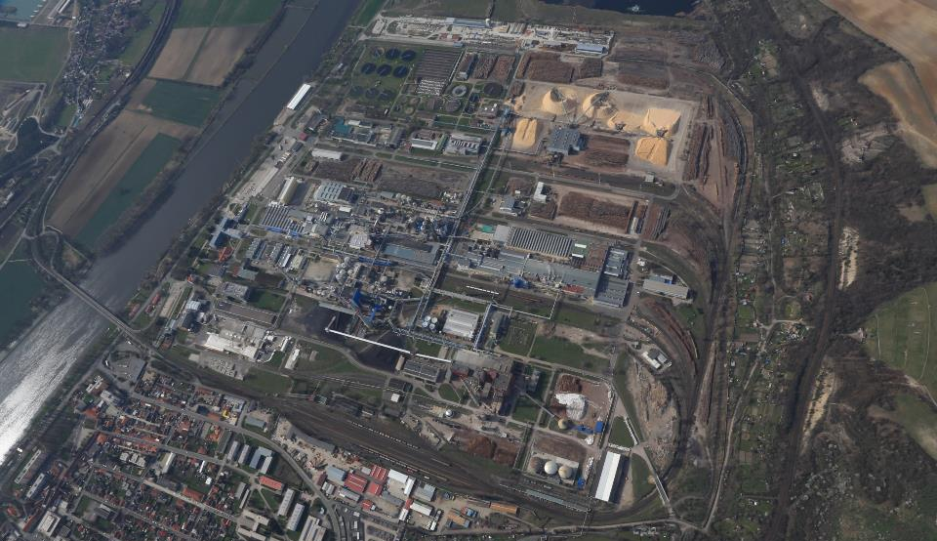
Welcome in Mondi Štětí

Slide 7
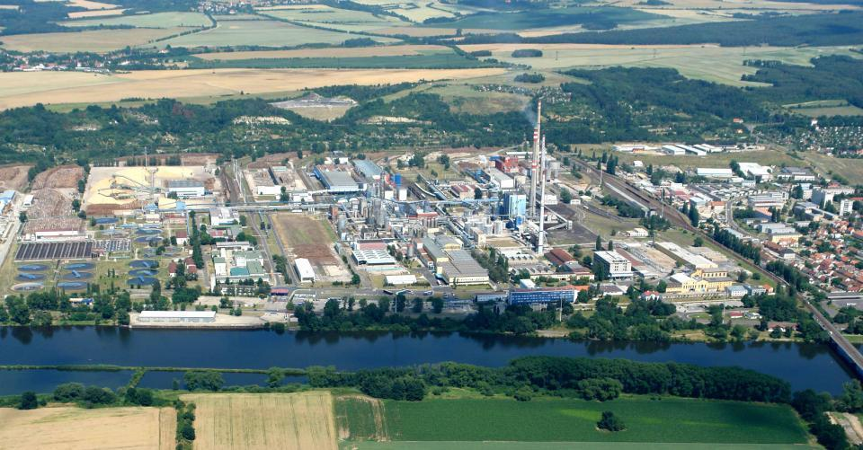
Mondi Štětí
Woodyard
Mondi Bags
PM5
PM 7
Dryer
Energy Dept.
Recovery
Pulp
Mondi Coating
Water-treatment Plant
SPM s.r.o.
PM1
PM3,6 Coater

Slide 8
Company history since 1992
Mondi
Ownership
Full ownership (91%) of AssiDomän,
Sale of ROTO a.s. to Norske Skog
CR entry into EU
New PM7
New PM6
Start up new cooking plant-SB
EcoFlex approved
PM3 rebuilt
New PM6 coater
Ownership AssiDomän & Stratton SEPAP,a.s.
& SEPAP Štětí a.s.merger
Re-purchase ROTO
Privatization & Restructuring (SEPAP)
1992 1993 1995 1997 2000 2002 2004 2008 2009 2014 2015 2017
Notes:
8

Slide 9
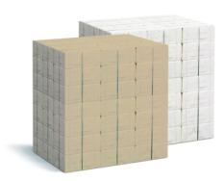
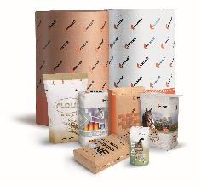
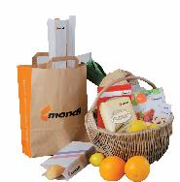
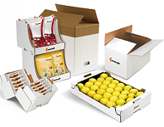
Our products
    Market bleached pulp
    Sack kraft paper
    Speciality kraft paper (SF Paper and Machine glazed papers)
    Containerboard

Slide 10
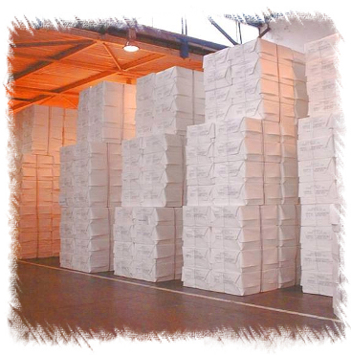
Bleached Pulp
High strength of fibre and high tear strength.
Excellent for reinforcing purposes.
Magazine papers (LWC, SC).
Sack kraft papers.
Speciality kraft papers.

Slide 11
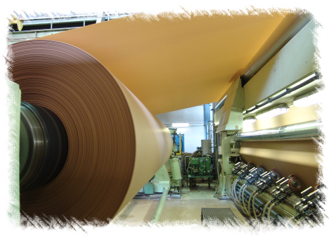
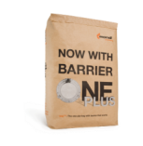

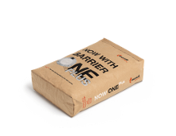
PM5
Manufacturing sack kraft paper (standard, semi-extensible).
End-use: paper sacks for powder material wrapping

Slide 12
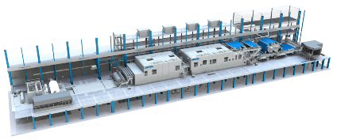
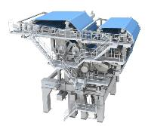
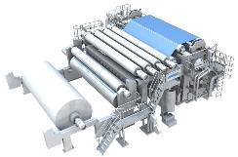
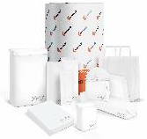
PM7
Manufacturing
White sack kraft paper (standard, semi-extensible).
Speciality kraft paper: smooth finished white papers (calandered papers with perfect printability and gloss)
Containerboard
End-use: paper industrial bags for powder material wrapping, shoping bags,lamination, FFS bags (for sugar, flour, rice, …), ...

Slide 13
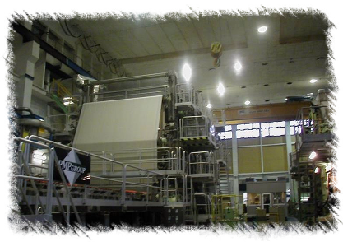
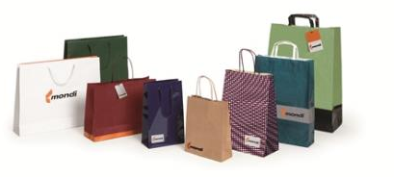
PM 6 & 3
Machine glazed paper (MG):
light / medium-weight paper where one side is polished and has high gloss and back-side remains matt with rough surface.
End-uses are various packaging, protecting and lamination applications.

Slide 14
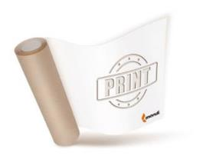
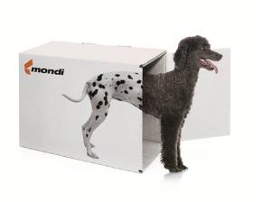
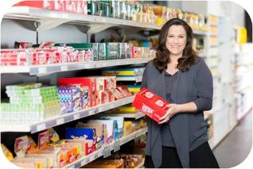

PM 1
Containerboard is used in corrugated boxes.
ProVantage portfolio:
The Containerboard is two-ply and fibers range from 100% kraft pulp to selected secondary fibers.

Slide 15
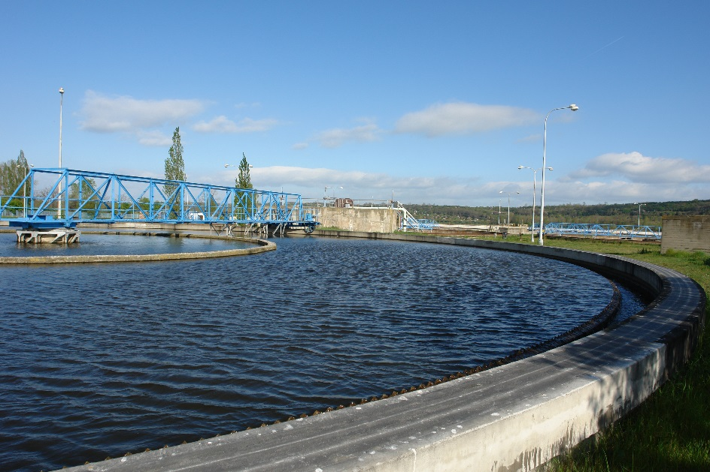
Environment
2007-2017
Increased production of paper by 20%
And in the same time
Reduced emissions of dust to air by 25%.
Reduced emissions of odor by 75% and complaints of odor by 50%
Reduced AOX emissions to water by 15%
Reduced process water consumption by 18%

Slide 16
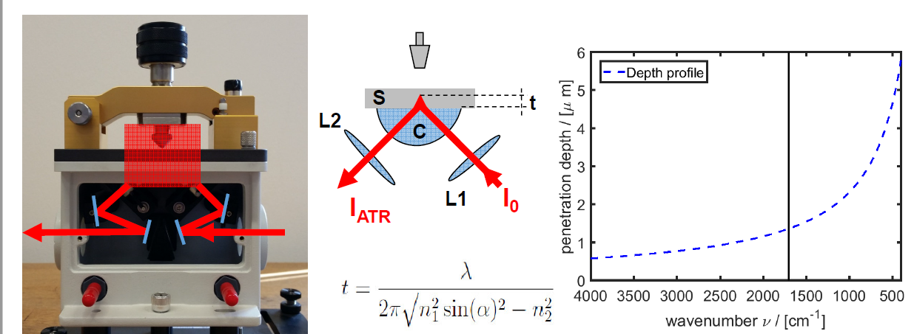
Research & Development
Focus is concentrated to the higher added value product to customers - controlled by HQ
Simultaneously is closely monitored all costs and environmental impact
Log term cooperation with University Pardubice, STU Bratislava, RISE Stockholm, VUPC Bratislava ( research works + diploma thesis , BC thesis)
Research program with UJEP Usti nad Labem started 2017, focused on environmental issues

Slide 17

Safety focus

Slide 18

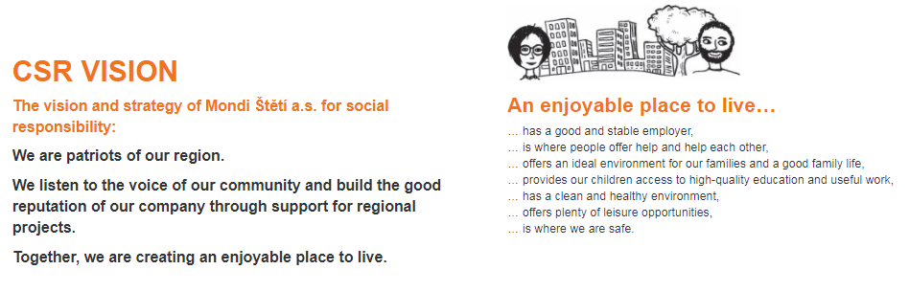

Slide 19
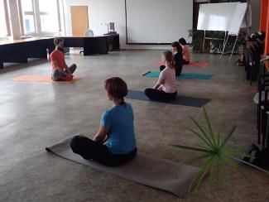
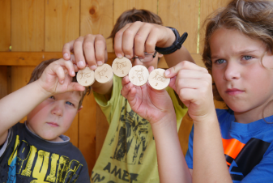
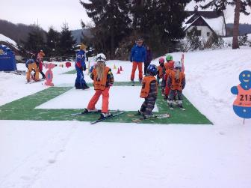


Mondi for Life

Slide 20
Vyšší odborná škola obalové techniky
Obor : Obalová technika (od r. 2010)
Školní vzdělávací program: Obalový a grafický design
Délka : 4 roky
Střední vzdělání s maturitní zkouškou
Maturita:
  Praktická zkouška - 2 dny, Obalový a grafický design
  Ústní zkouška – 15 min každý předmět , Obalová a tisková technika
Organizace výuky: teoretická, praktická
Zahájení: září 2017
Počet studentů: 20

Slide 21



Vyšší odborná škola obalové techniky

Slide 22
Předměty
Fyzika 1. ročník
Technické kreslení 1. ročník
Chemie 1. - 2. ročník
Informatika 1. - 2. ročník
Obalové materiály 1. - 2. ročník
Matematika 1. - 4. ročník
Obalová technika 2. - 4. ročník
Tiskové techniky 2. - 4. ročník
Odborná praxe 2. - 3. ročník (vždy 2 týdny)

Slide 23

Další formy spolupráce při vzdělávání
Výuka lektorů
Licenční studium – Univerzita Pardubice
Účast v teoretické výuce
Přednášky, workshopy odborníků MŠ
Exkurze
Úprava osnov
Spolupráce při praktické výuce
14 denní souvislá praxe včetně obhajoby práce
Praxe

Slide 24
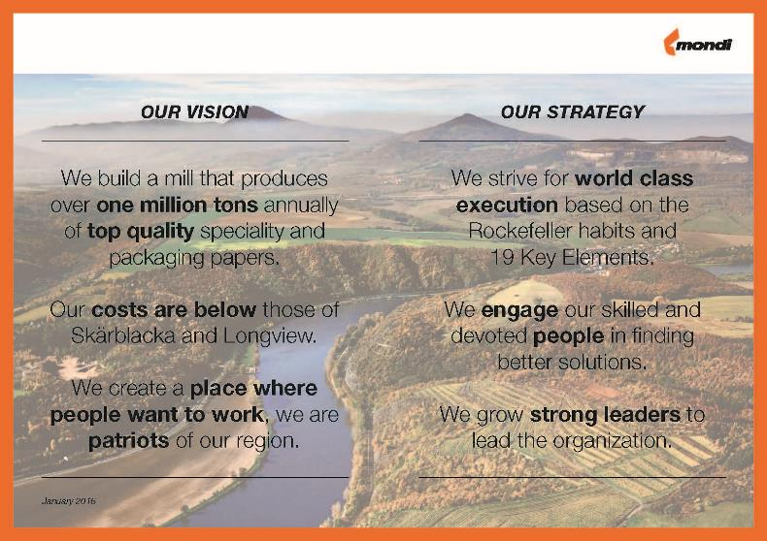
Vision and Strategy

Slide 25
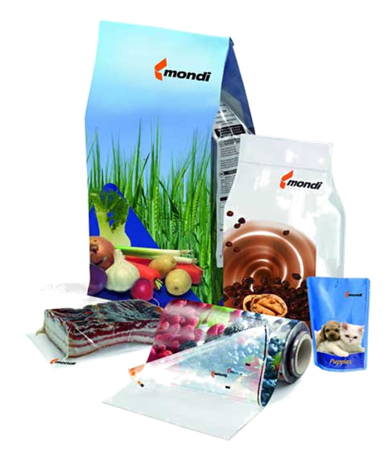
THANK YOU FOR YOUR ATTENTION !

